Slide 1

Lesson 11: CN4005
Mental Wealth
Topics: Starting and funding your business
Dr Fadi Safieddine
1

Slide 2

Presentation content
What are the different types of business
How to set up a business?
What is Crowd funding?
2

Slide 3

Types of businesses
Sole trader: an individual operating as the sole person legally responsible for all aspects of the business. Like other structures, as a sole trader you can employ people to help you run your business.
Partnership: an association of people or entities running a business together, but not as a company.
Company: A company come into existence when a group of people come together with a view of forming an association to exploit the business opportunities by bringing together; men, material, money and management.

Slide 4

Funding
Capital is lifeblood of any business It is the most essential and important element of business

Slide 5

Crowdsourcing = crowd + outsourcing
Definition “the act of taking a job traditionally performed by a designated agent (usually an employee) and outsourcing it to an undefined, generally large group of people in the form of an open call” (Crowd Sourcing Week, 2013)
Basic premise is that IT allows ideas and efforts to be openly shared over the Internet and facilitates new forms of connections.
Related to the concepts of open innovation, co-creation, collective intelligence, user innovation and open source.
Includes activities include: (content generating, Wikipedia), micro-tasks executed by large paid crowds (crowd labour), policy and regulatory input (e.g. Red Tape Challenge), crowd journalism, and crowd funding.
Crowdsourcing Week. 2013. Why Crowdsource? - Crowdsourcing Week. [ONLINE] Available at: https://crowdsourcingweek.com/blog/why-crowdsource/. [Accessed 23 March 2020].

Slide 6
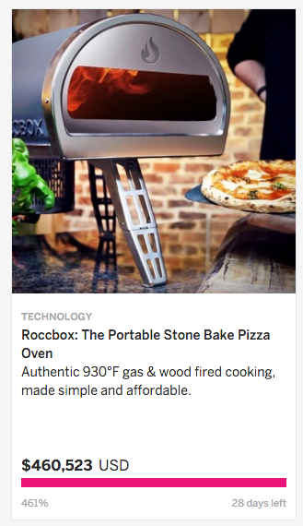
Crowdfunding
The Internet has always been about raising funding contributions from large audiences
Crowdfunding involves from community projects and charitable giving to new product development and highly innovative ideas (e.g. Kickstarter, Indie Go Go)
Usually involves ‘perks’ like a special edition of the product or the first X products if developed
Finding the right “crowd” can be helpful as a marketing tool in addition to raising funds !
Equity crowdfunding is a different idea that works as an investment vehicle (e.g. Seedrs, Crowdcube)
Source: Indie Go Go

Slide 7
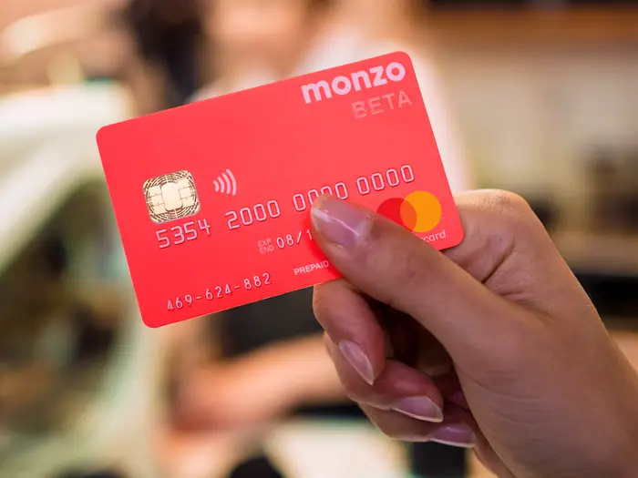
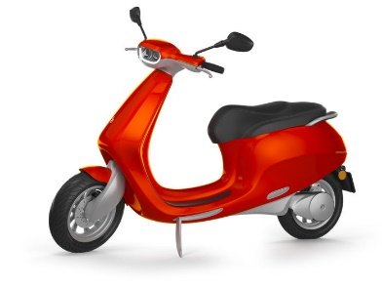
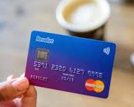
Examples of successful UK CF projects
Monzo bank (raised £2.5m via Crowcube)
Bolt Mobility, Electric motorbikes (£2.8m via Seedrs)
Revolt Bank (raised £3.9m via Seedrs)

Slide 8
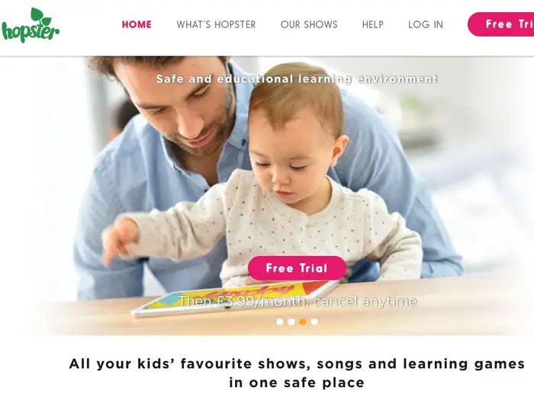


Examples of successful UK CF projects
Hopster(raised £4.8m via Venture Founders) kids TV.
Microdrone 3,(raised £2.8m 2015)
Kokoon headphones (raised £1.6m 2015)

Slide 9
End of Part 1
Activity 11.1: What is the one thing that is common between all those ideas that got so much funding?
New ideas
Innovative ideas
Cheap ideas
Ideas that someone else had come up with before.
All of the above.

Slide 10
Are people just happy to throw their money?
Part 2

Slide 11
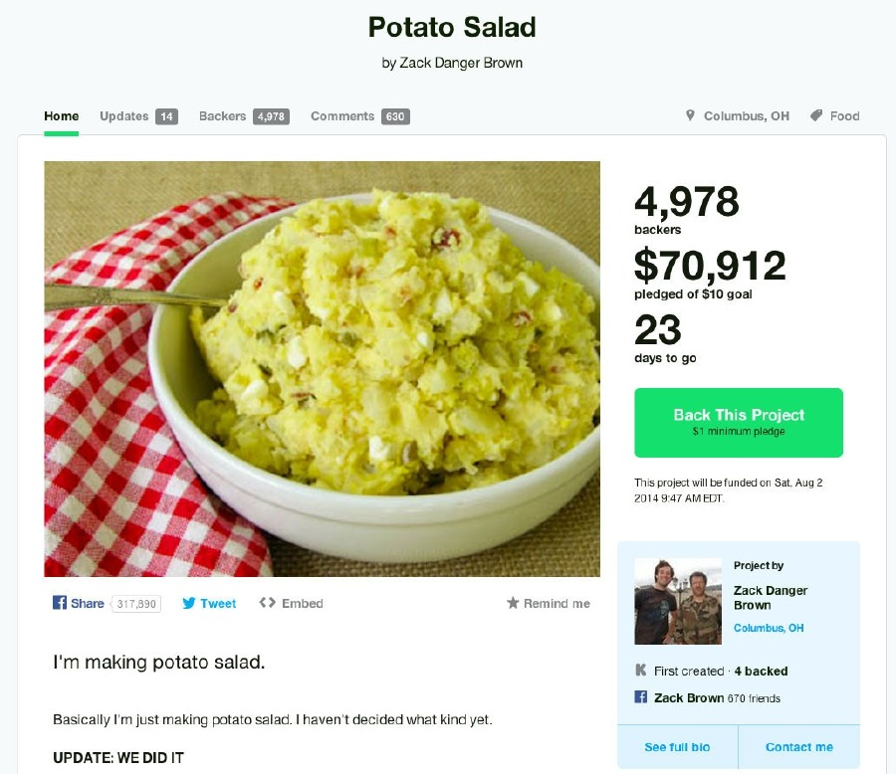
Are people just happy to throw their money?
People will
reward
creativity!

Slide 12
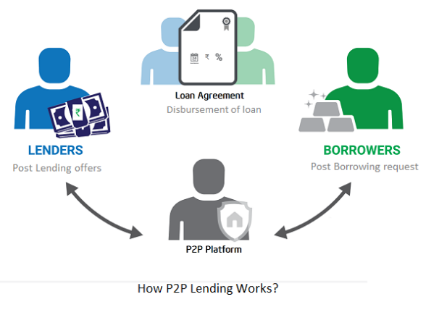
Social or peer-to-peer lending
Peer-to-peer or social lending is the practice of matching lenders and borrowers through a platform that mediates the relationship
More recently, such schemes have become more regulated and mainstream to the UK public via tax-free allowance accounts (ISAs)
The P2P lending platform Zopa exists since 2005, hence survived the financial crisis of 2008 - 2009!
Source: Quora

Slide 13






From creation to consumption: the sharing economy
Consumer-to-consumer (C2C) platforms and applications
Temporary access to goods without transfer of ownership
Sharing physical assets based on an on-demand economy
Sharing or access economy? This is about convenient new value propositions, not exactly sharing because “low levels of trust between strangers when there is no market mediation”

Slide 14
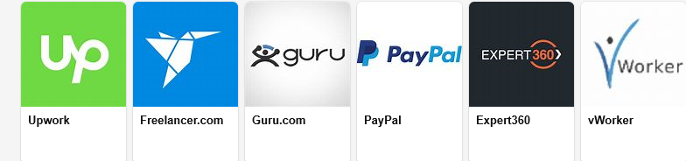
Freelancing Platforms
Freelancing platforms are places where businesses and independent professionals connect and collaborate remotely.

Slide 15

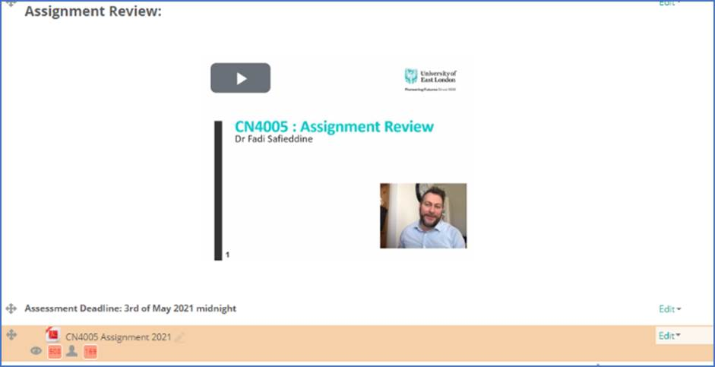
Please refer to the assignment
Formative Feedback on final report

Slide 16
End of Part 2
Activity 11.2. If you set up a consultancy company and link to a website that allows project get sent to you, this is what we call:
Free economy
Gig economy
Capitalist economy
Online economy

Slide 17

Next lesson:
Showcasing best ideas

